Slide 1
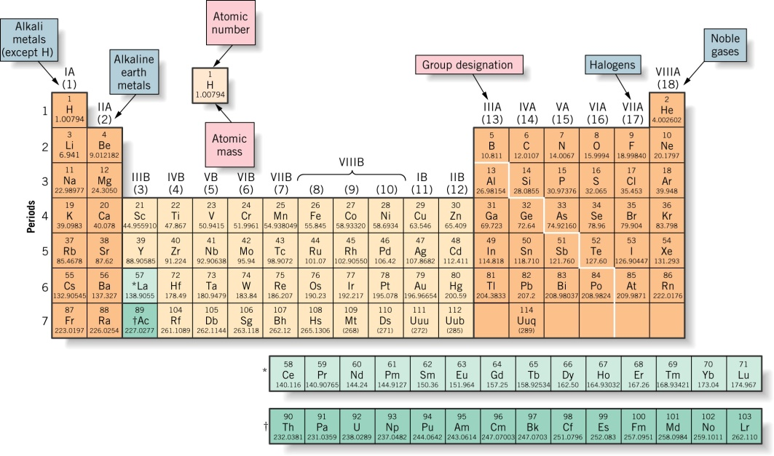
CHGM-141
General and Analytical Chemistry
Lecture 4(b)
(Ch. 1) with Dr. Bailey
Molar Mass

Slide 2
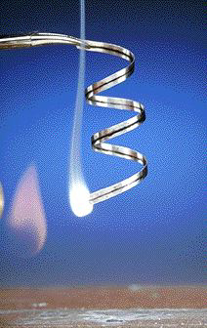
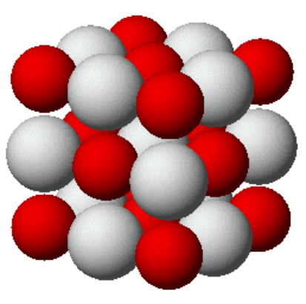
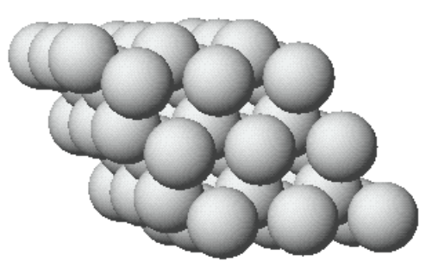
Counting Atoms
Mg burns in air (O₂) to produce white magnesium oxide, MgO.
How can we figure out how much oxide is produced from a given mass of Mg?

Slide 3
The Mole
How do we “measure” Chemistry in the Lab?
How do we describe chemical recipes and the reactions of chemical formation?
Chemistry is a quantitative science—we need a “counting unit.”
Introduce the most important aspect of Chemistry.

Slide 4
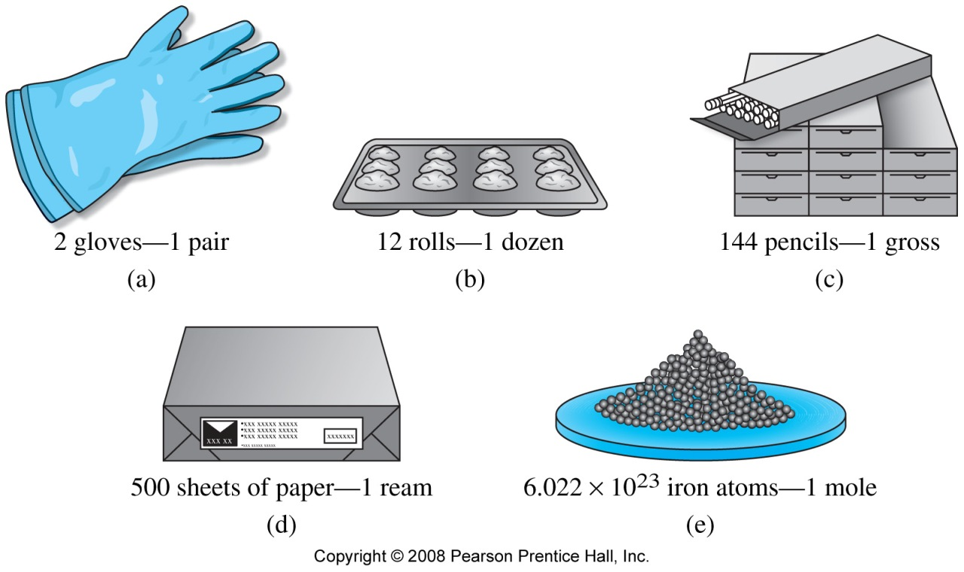

Slide 5
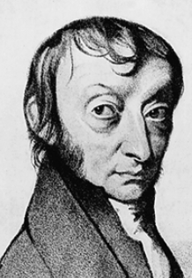
Particles in a Mole
Avogadro’s Number
Amedeo Avogadro
1776-1856
6.02214199 x 10²³
There is Avogadro’s number of particles in a mole of any substance.

Slide 6
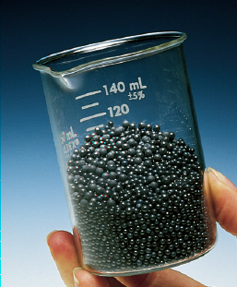
Counting Atoms
Chemistry is a quantitative science—we need a “counting unit.”
MOLE
1 mole is the amount of substance that contains as many particles (atoms, molecules) as there are in 12.0 g of ¹²C
518 g of Pb, 2.50 mol

Slide 7
Counting formula units by moles is no different than counting eggs by the dozen (12 eggs) or beers by the case (24 beers)
Avogadro’s number is huge because atoms and molecules are so small: a huge number of them are needed to make a lab-sized sample
Avogadro’s number links moles and atoms, or moles and molecules and provides an easy way to link mass and atoms or molecules
Let’s go into this in more detail…

Slide 8
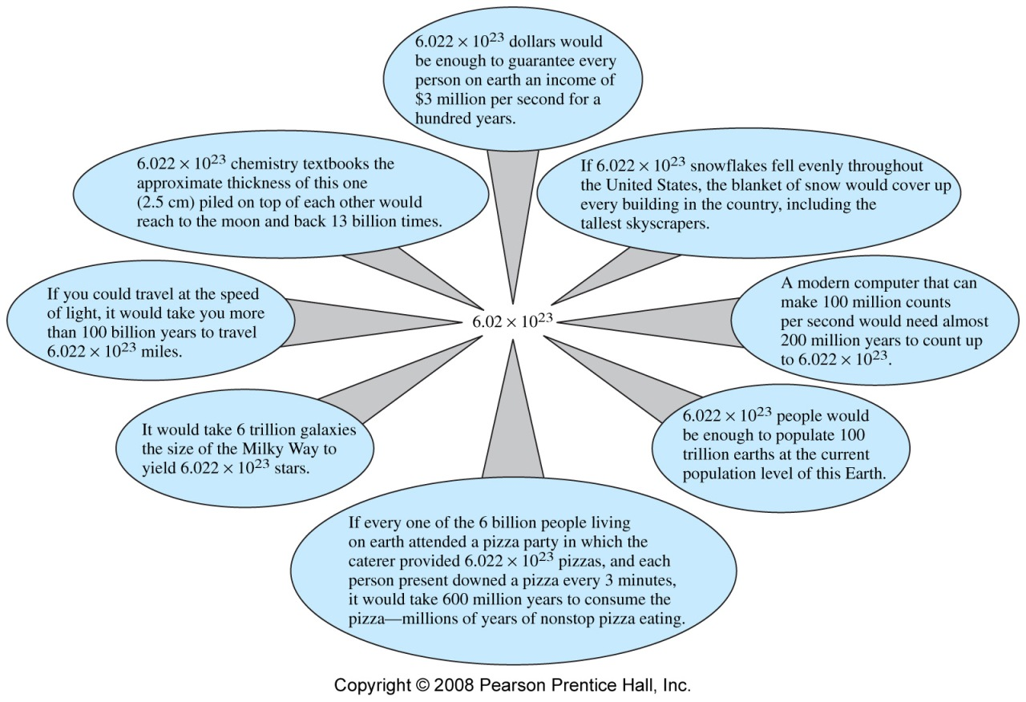

Slide 9
In the lab we use Mass…
We need some way of linking mass (macroscopic) with amount of atoms or molecules (microscopic)
Counting atoms…the amount…

Slide 10
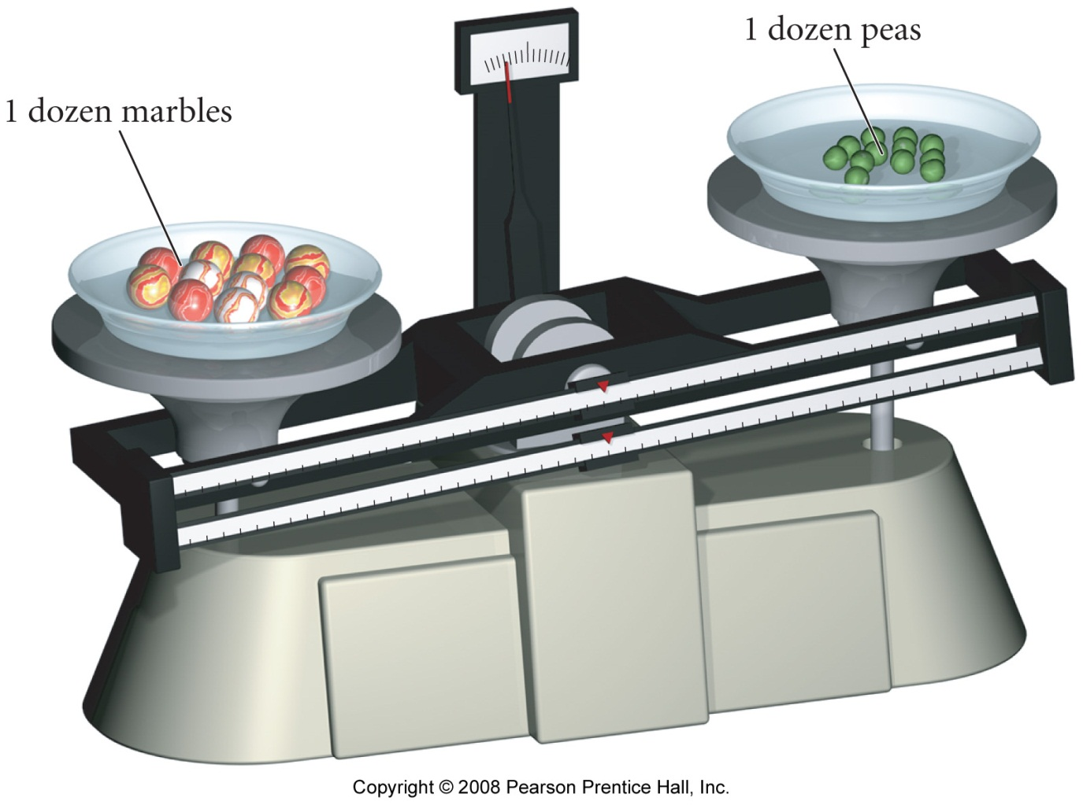
Which weighs more, a pea or a marble?
Pea
Marble

Slide 11
Which weighs more, a pea or a marble?
Pea
Marble

Slide 12
Molar Mass
The mass in grams of one mole of any element (6.0221415x10²³ atoms) is the molar mass of that element

Slide 13
Molar Mass
An element’s molar mass is the amount in grams numerically equal to its atomic weight.

Slide 14
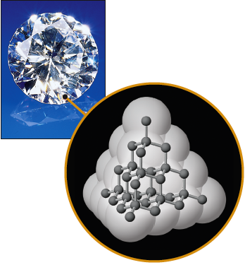
Molar Mass
1 mol of ¹²C
= 12.00 g of C
= 6.022 x 10²³ atoms of C
12.00 g of ¹²C is its MOLAR MASS
Taking into account all of the isotopes of C, the molar mass of C is 12.011 g/mol

Slide 15
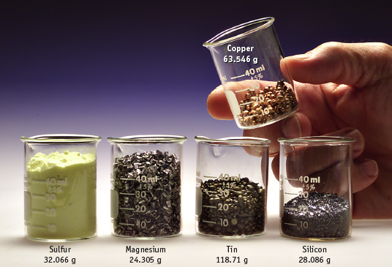

One-mole Amounts

Slide 16
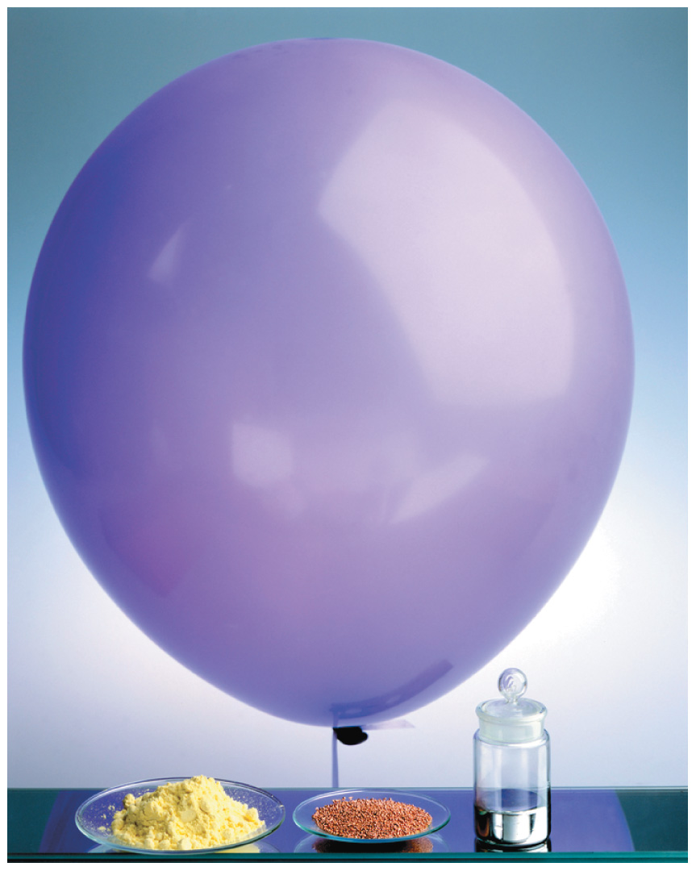
Atomic Masses, Atomic Weights, and the Mole

Slide 17
What is molar mass of :
Litium?
Iron?

Slide 18


Slide 19
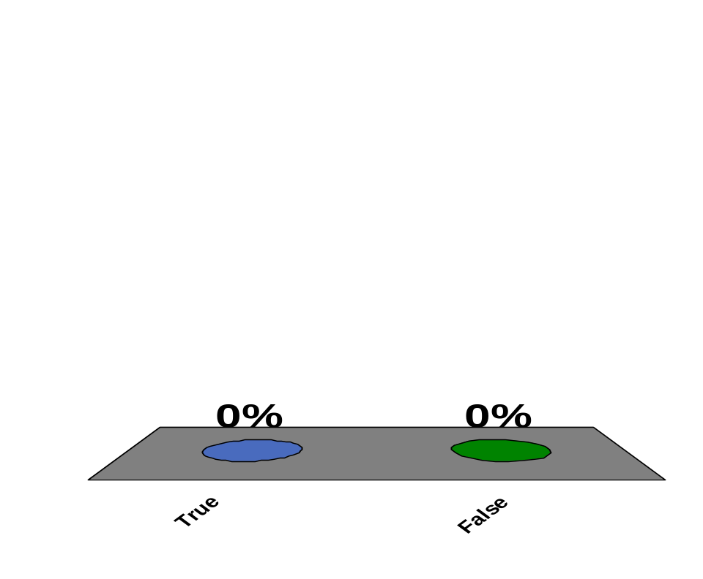
One mole of lithium and one mole of hydrogen weigh the same?
10
True
False
1 | 2 | 3 | 4 | 5

Slide 20
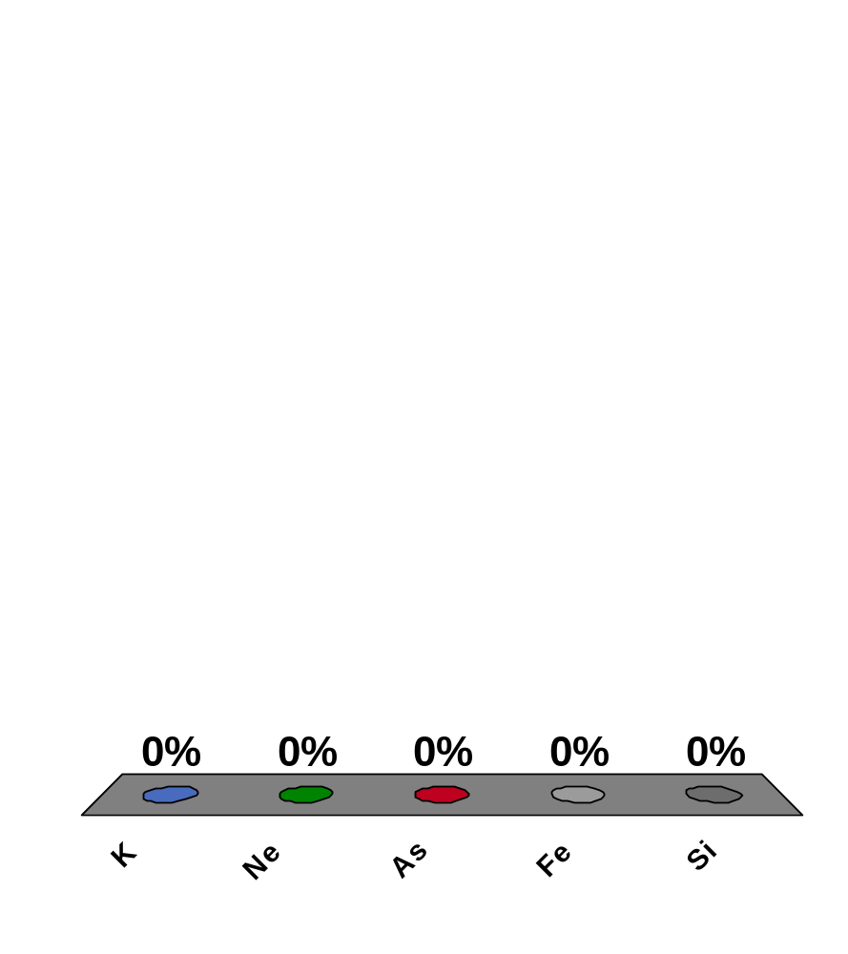
Which of the following elements has the largest molar mass?
10
K
Ne
As
Fe
Si
0
of
5

Slide 21
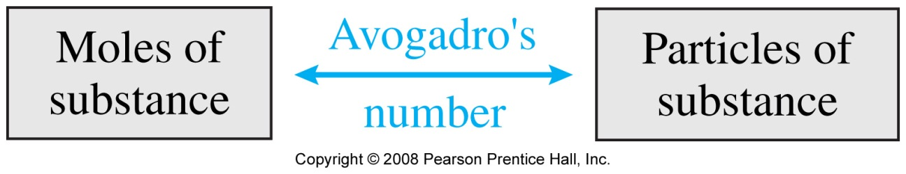
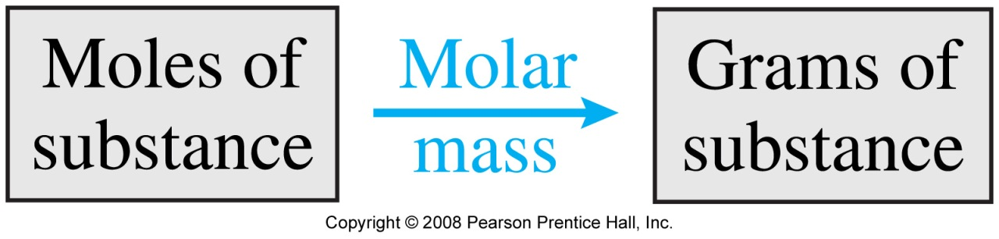
Very common calculation

Slide 22
PROBLEM: How many Cu atoms there in 2.00 moles of Cu?

Slide 23
Poblems:
How many grams of Ca are in 1.00 moles?
In 4.55 moles?
2) How many moles of nickel are in 44.03 grams?

Slide 24
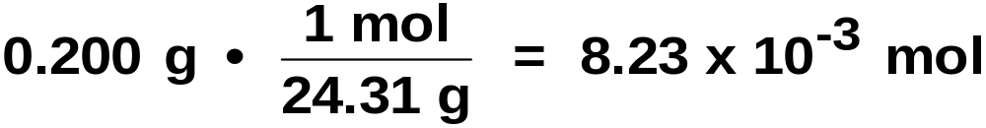
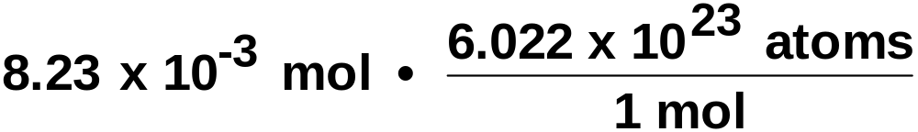
PROBLEM: What amount of Mg (number of moles) is represented by 0.200 g? How many atoms?
Mg has a molar mass of 24.3050 g/mol.
How many atoms in this piece of Mg?
= 4.95 x 10²¹ atoms Mg

Slide 25
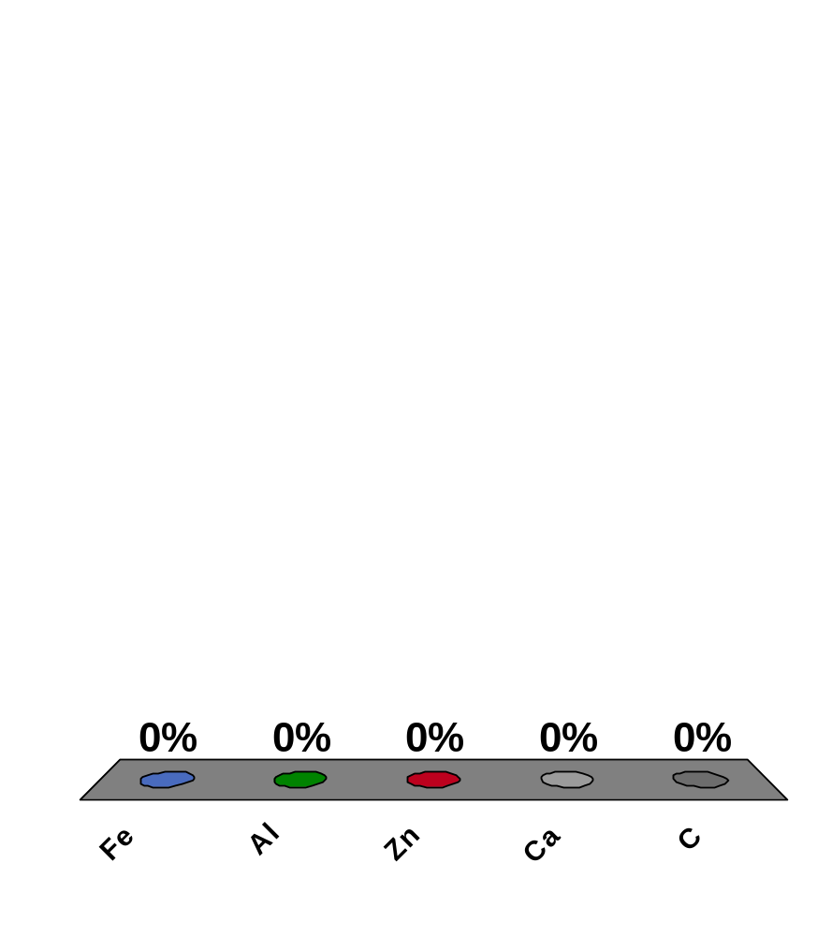
You have 0.25 mol of each of the following elements. Which one has the largest mass?
10
Fe
Al
Zn
Ca
C
0
of
5

